Slide 1

EL PROGRESS REPORT
2
+
CREDIT CARD FRAUD DETECTION
2
+
CS3203 DS & ML Project
Submitted By:
Tushar (209301387)
Sec: VI B

Slide 2

Introduction
Security is a vital part of every bank’s business and as credit cards are major for their business, it is crucial that credit card fraud should be kept in check.
New York Times has claimed that most of the American users with accounts in the United States are susceptible to fraud and more than 1% of users encounter this problem.
To prevent credit card fraud, first an analysis on where fraud is occurring and how it can be detected with a good accuracy should be understood.
These facts have led experts to believe that time and money should be invested in detecting fraud through data science, machine learning and analysis of transaction data to find reasons and factors related to Credit Fraud.

Slide 3
About Dataset
Data source:
The dataset has been collected during a research collaboration of Worldline and the Machine Learning Group of ULB (Université Libre de Bruxelles) of Brussels on big data mining and fraud detection.
The dataset contains transactions made by credit cards in September 2013 that belong to cardholders across Europe.
This study was made to first find the spread of fraudulent users and then identify how many are being done and as a project to the University, we will successfully help ULB in finding out the best algorithm out of three good machine learning algorithms.
This data was obtained from https://www.kaggle.com/datasets/mlg-ulb/creditcardfraud

Slide 4
About Dataset
Dataset details: Credit card transaction dataset
This is a huge dataset with 284,807 records out of which 492 are fraudulent and the other 284309 are clean transactions.
There are 31 attributes in the dataset out of which 29 are features for fraud detection, and one target variable.
The target variable is the only variable that classifies people as a person committing fraud or a clean person who does not commit any fraud.

Slide 5
About Dataset
Attribute details:
Time: The number of seconds elapsed between each transaction and the first selection of the dataset.
Amount: The amount of money used by the cardholder in the respective transaction.
V1 – V28: V1 to V28 are 28 principal components extracted on performing a comprehensive Principal component transformation/analysis (PCA).
Target: ‘Class’ or the target variable is the responsible variable. It is binary and shows 1 in case of fraud and 0 otherwise.

Slide 6
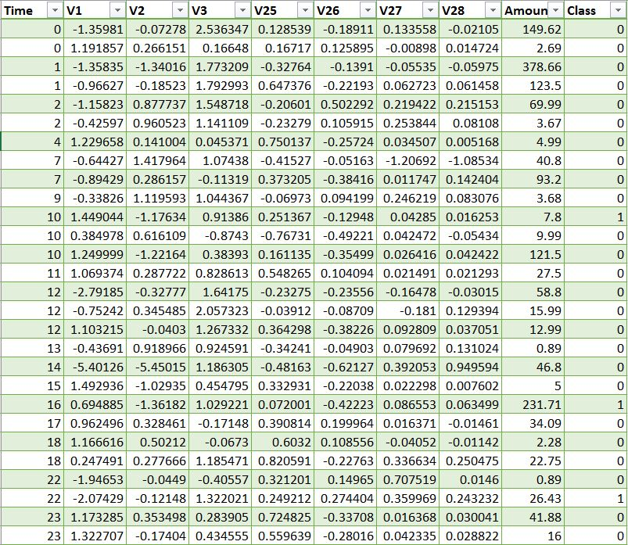
Data Sample

Slide 7
Requirements
Tools:
->Python (3.9) for writing code to execute and find out accuracy of the problem.
->Jupyter (ipnyb) to have a proper flow through the code in the form of a notebook
Libraries:
-> Pandas, Numpy are used for storage, tracking, data frames and data handling.
-> Mathplotlib is used for visualizing data.
-> XGBoost, DTClassifier, RFClassifier, Scikit-learn are used to perform machine learning algorithms.

Slide 8
Data Preparation
For data preparation the data set will be cleansed and transformed. The data set
is reviewed for the following :
Handling the missing values and outliers if any.
Finding attributes that require transformation in the data.
Selecting the appropriate values necessary for analysis.

Slide 9
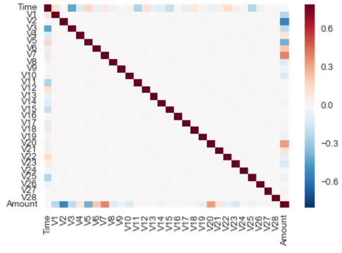
Data Preparation
Heat map to verify correlation between the components.
A straight line suggests that it was correctly performed.
Feature Engineering: (PRINCIPAL COMPENENT ANALYSIS)
Before getting to the point where we find outliers, remove them or normalize the data or see which data is used for which iteration, a prime component of this data is the PCA.
The features that were obtained in the data were obtained by choosing numerical data such as details of customers, transaction location, Business of the merchant and other details that are kept confidential due to the university and credit card issuing authority policy.
From a total of 43 attributes that were present in the banks database, a PCA was run and 28 important features were obtained.

Slide 10
Data Preparation
Handling the missing values: Since this data was collected manually and through remote systems, the data was accurate and no missing values exist.
Transformation: The attribute ‘Amount’ was Normalized while running the last iteration because a clear imbalance was seen that was affecting the precision of the model output.
Outliers: This data does not have any outliers as it is a combination of features and Binary variables.
Irrelevant Data handling: The variable ‘Time’ was deemed irrelevant after a few iterations and was ignored from the main calculations.

Slide 11
Modeling
Since the data that is being dealt with is binary and needs to be classified into either fraudulent or non-fraudulent data, three suitable machine learning algorithms are used in this case to perform data mining on credit card transactions.
-> Logistic Regression
-> Random Forest Classifier.
-> Decision Tree Classifier.
-> XG Boost algorithm.

Slide 12
Modeling – Logistic Regression
It is the Supervised Learning technique used for predicting the categorical dependent variable(predicted variable (class) ) using a given set of independent variables(predictors (our independent variables)(v1 to v28)
It predicts the output of a categorical dependent variable. Therefore, the outcome must be a categorical or discrete value. It can be either Yes or No, 0 or 1, true or False, etc. but instead of giving the exact value as 0 and 1, it gives the probabilistic values which lie between 0 and 1.

Slide 13
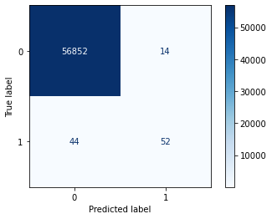
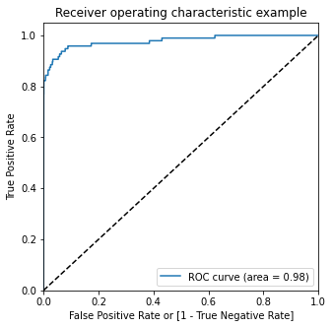
Logistic Regression – Confusion Matrix & ROC

Slide 14
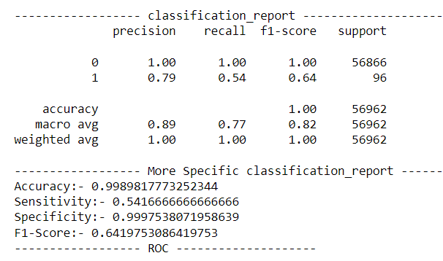
Logistic Regression – Analysis

Slide 15
Modeling – Decision Tree Classifier
A decision tree classifier is an upgrade on the CART algorithm and it is a predictive modeling technique that uses classification trees and conjunctions to solve problems on classifications.
Data is in the form of (x,Y) -> (x1, x2, x3, ……. Xk, Y)
The advantages are:
-> Highly detailed.
-> Very good accuracy.
Disadvantage is that:
-> Decision Tree classifiers are very slow and time consuming to execute.

Slide 16
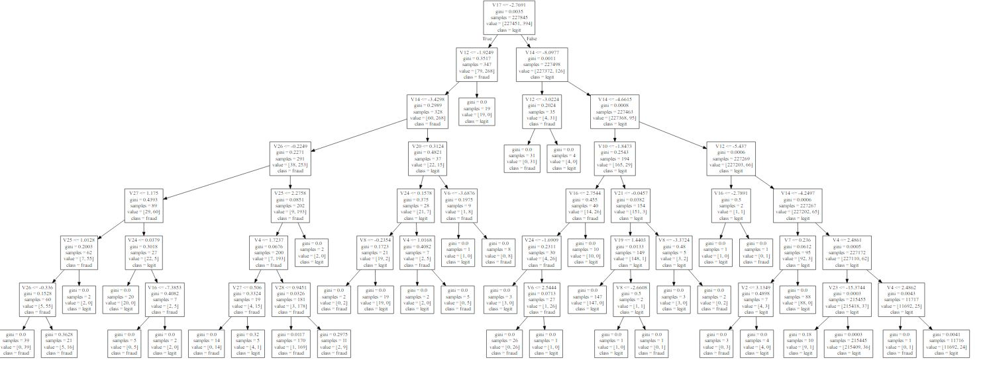
Modeling – Deriving Rules for Decision Tree
Based on the features obtained by Principal Component Analysis, from V1 to V28, rules have been derived below for Decision Trees.

Slide 17
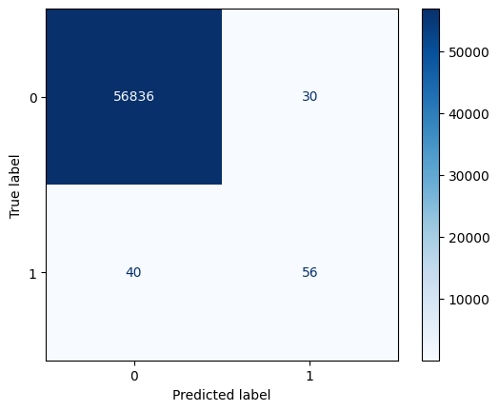
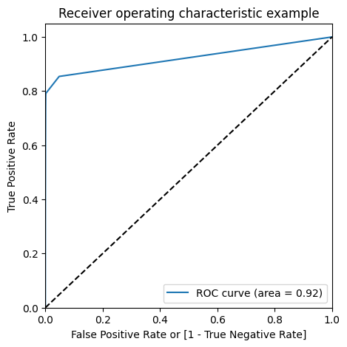
Decision Tree – Confusion Matrix & ROC

Slide 18
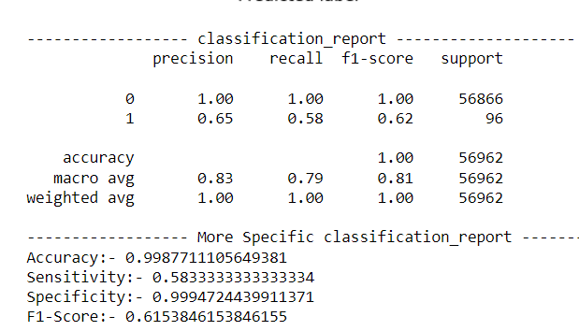
Decision Tree – Analysis

Slide 19
Modeling – XG Boost Technique
XGBoost is a tree-based ensemble machine learning algorithm that is highly effective for classification problems. It is known for its speed, scalability, and accuracy. XGBoost is used in credit card fraud detection to identify fraudulent transactions by building a model that learns from the patterns and anomalies in the data.
An implementation of Gradient Boosted decision trees which is a machine learning technique for regression or classification problems which produces a prediction model in the form of an ensemble of weak Prediction models.
Typical, an advanced model of decision trees.

Slide 20

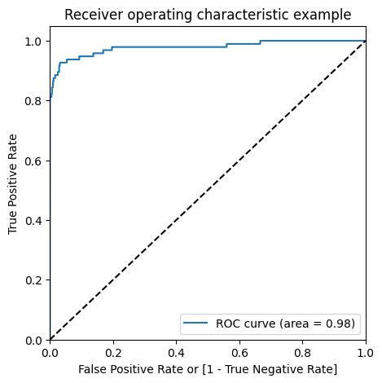
XGBoost – Confusion Matrix & ROC

Slide 21
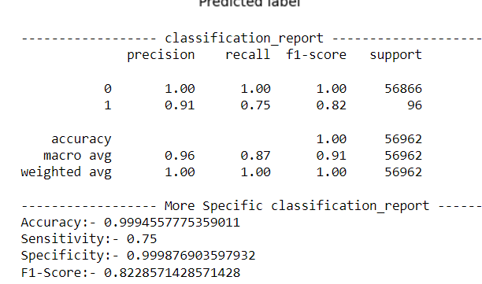
XGBoost – Analysis

Slide 22
Modeling – Random Forest Classifier
A technique based on decision trees, Random Forest is an advanced ensemble learning method to classify the data into significant classes.
The advantages of Random Forest are:
-> It has very low sensitivity to outliers.
-> A very high accuracy is obtained.
The disadvantages of Random Forest Classifier is that it is:
-> Highly time consuming.

Slide 23

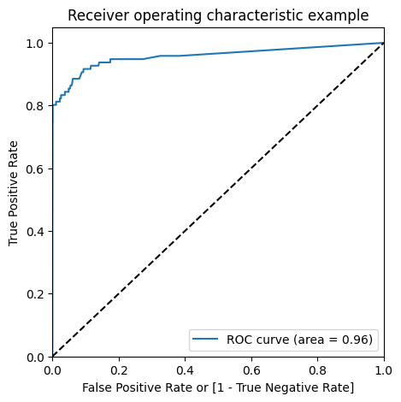
Random Forest – Confusion Matrix & ROC

Slide 24
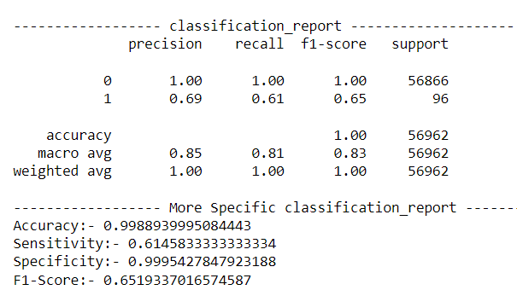
Random Forest – Analysis

Slide 25
Conclusion
After conducting an extensive analysis of credit card transactions data and employing various machine learning algorithms such as logistic regression, decision tree, xgboost, and random forest, we can conclude that these models are highly effective in detecting credit card fraud.
Overall, the results of the experiments demonstrate that the Random Forest model is the most accurate in identifying fraudulent transactions, followed by XGBoost, Decision Tree, and Logistic Regression.

Slide 26
References
www.kaggle.com
www.kdnuggets.com
http://www.analyticbridge.com/profiles/blogs/random-forest-in-python
http://mines.humanoriented.com/classes/2010/fall/csci568/portfolio_exports/lguo/decisionTree.html
http://scikit-learn.org/stable/modules/generated/sklearn.tree.DecisionTreeClassifier.html
https://www.sas.com/en_us/insights/analytics/machine-learning.html
http://xgboost.readthedocs.io/en/latest/model.html

Slide 27
THANK YOU
2
+
2
+
THANK YOU

